Slide 1
Music Tracker
Where are my Vinyls?

Slide 2
Elevator Pitch
Objective
Track information about songs/albums
Target Group
Vinyl collectors
Music enthusiasts
Product
Lets you add, update and delete a song
Lets you see a list of songs that have been added
Have an accessible tool to refer to when shopping for vinyl records
Music trivia
You can login and have your own customised version of the tracker
Check it out: https://mtrackeraks.herokuapp.com

Slide 3
Concept
Motivation
Vinyl collectors who end up buying duplicate records
Description
MERN application deployed to Heroku to help the user have their own music library
User Story
AS someone who collects vinyl records
Wanting to know basic details about a song I am listening to
Add, Edit and Delete entries
Register or Log In
SO that I don't end up with multiple copies of the same record
I want a way to track the records that I own

Slide 4
Process
Technologies Used
MERN (MongoDB, Express, React, Node)
Challenges
POST and GET errors that persisted
Successes
Deployed 2 versions (with and without authentication)
PropTypes and Higher Order Components
Passport and JSON Web Tokens
Heroku
Authentication using Prop Types
Combining authentication with MERN
Heroku Deployment
They seem to work right now…
Switching ideas mid-way in the interest of time and making that work
Materialize, Redux

Slide 5
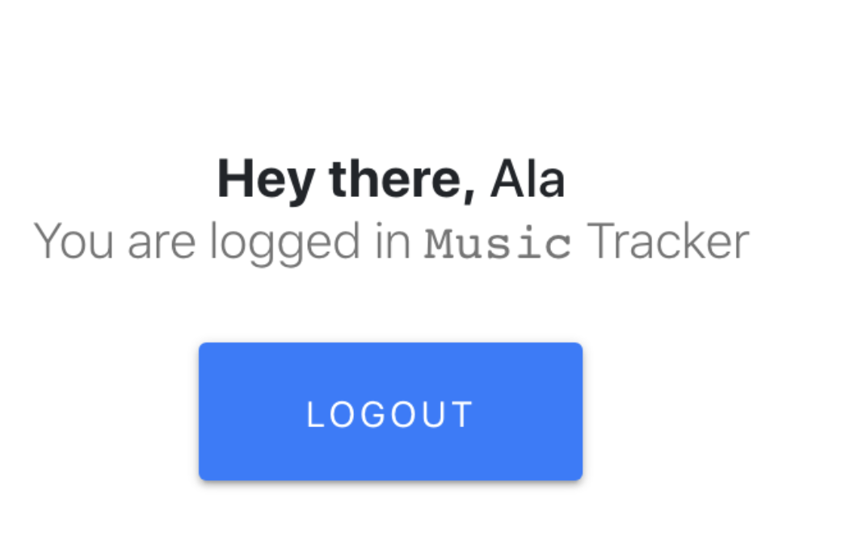
Demo
https://mtrackeraks.herokuapp.com

Slide 6
Future Development
Cross copyright hurdles and play songs
Marketplace with record stores nearby on a map
Add other users as your friends to see what records they own
Facilitate exchange of records (Venmo for records) and a virtual timer to remind you how long its been on loan for.
“On Loan”, “At Home” flagging to facilitate further tracking of record
Scanning where you can automatically scan information based on an image

Slide 7
Links
https://mtrackeraks.herokuapp.com
https://musicaks.herokuapp.com (without authentication)
https://github.com/aksCo/musictrackerAuth

